Slide 1
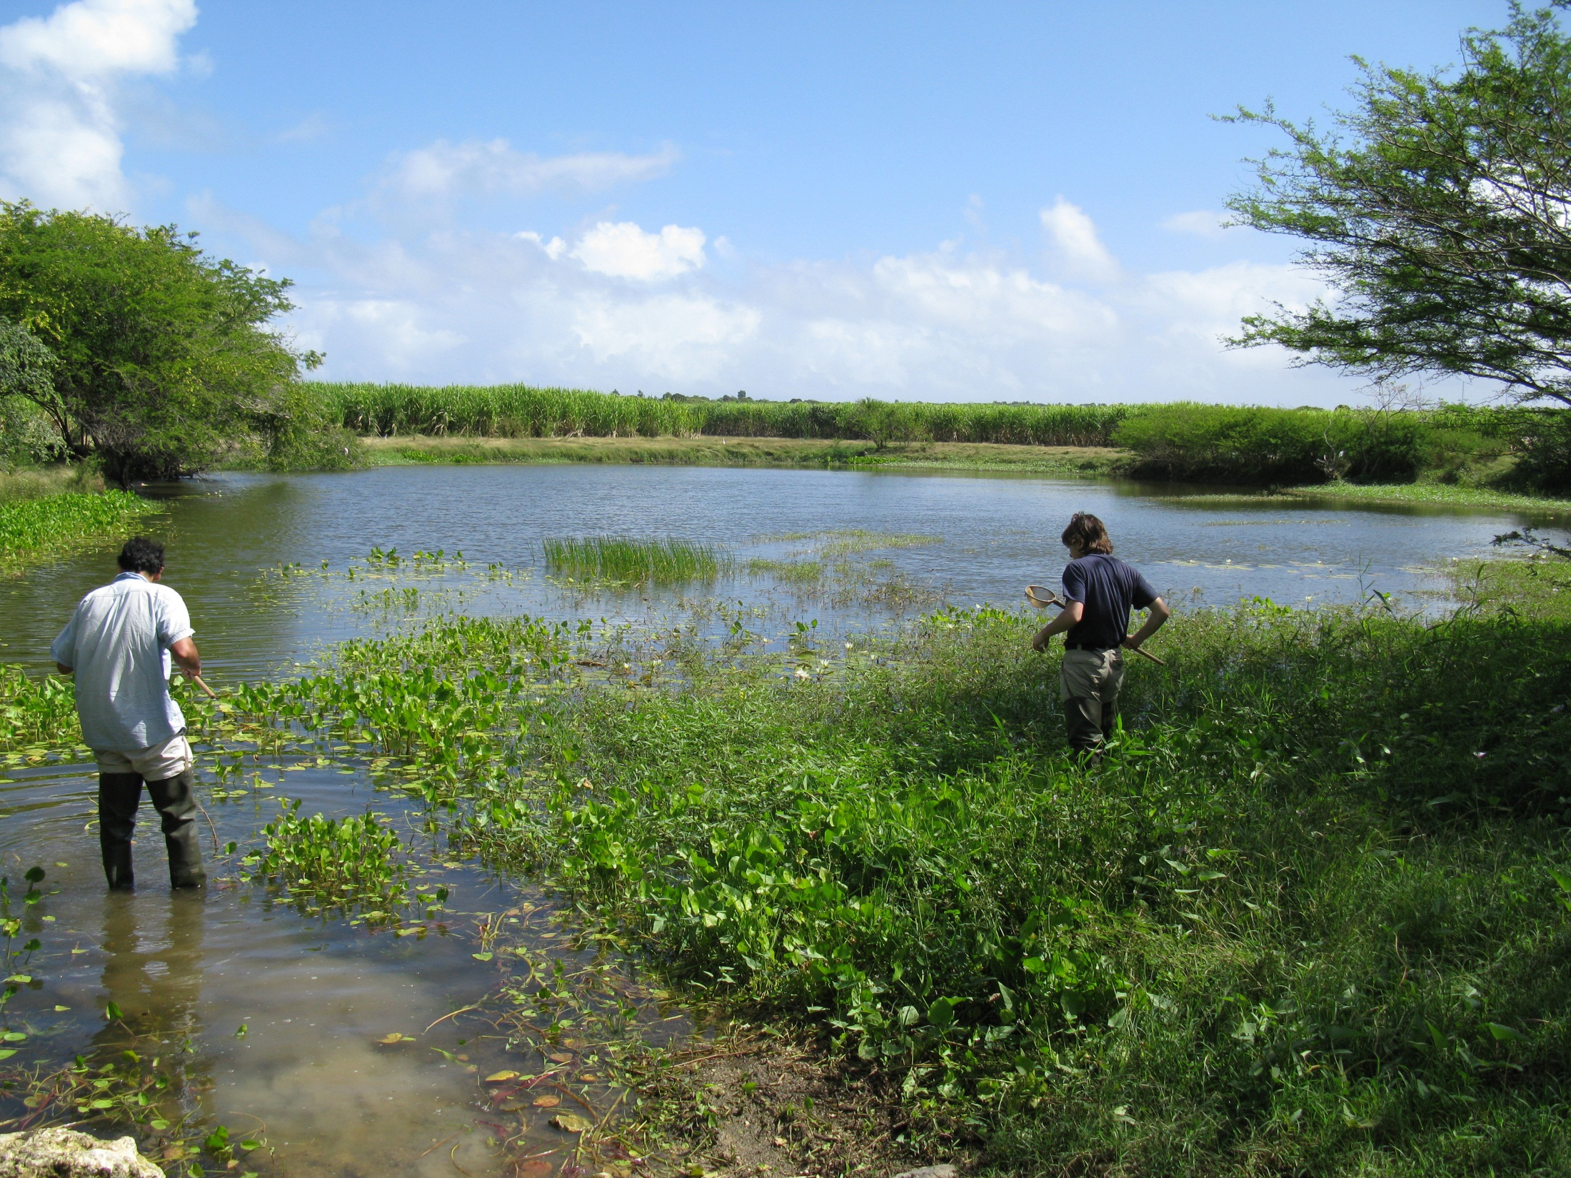
Metapopulation Genetics
A case study
The freshwater snail metacommunity in the French West Indies
Field survey in 2009 (credit: J-P Pointier)
Notes:
pond name = Mare Marie-Thérèse

Slide 2
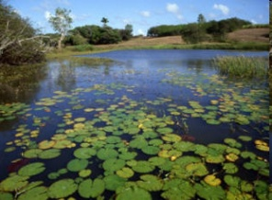
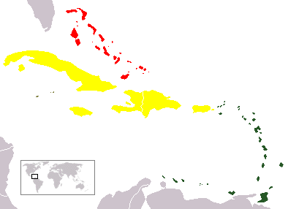
Freshwater ecosystems in the Guadeloupe archipelago
Bahamas
Greater Antilles
Guadeloupe archipelago
Caribbean Sea
Lesser Antilles
Grande-Terre
Basse- Terre
Notes:
The Guadeloupe archipelago is made of two main islands, Basse-Terre and Grande-Terre.

Slide 3
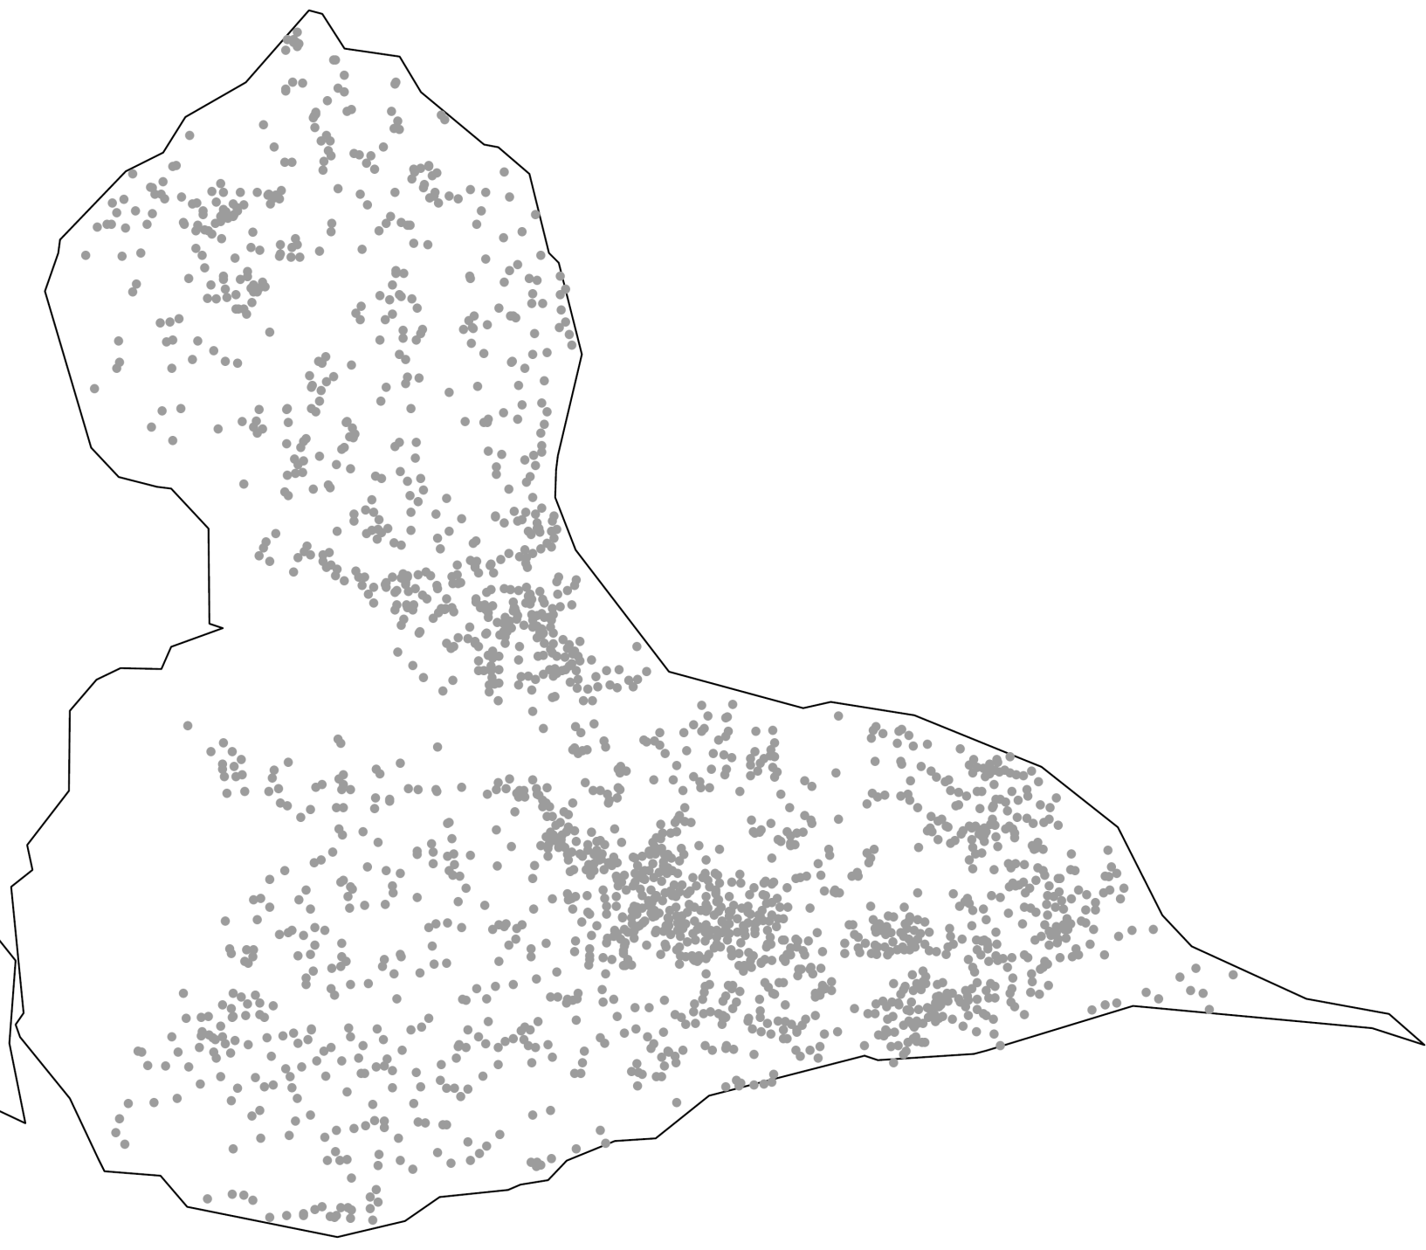
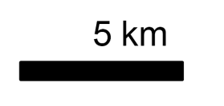

Freshwater ecosystems in the Guadeloupe archipelago
Grande-Terre: a naturally fragmented system
588 Km²
2059 ponds
one pond
Notes:
Grande-Terre is composed of a dense network of more than 2,000 ponds that forms a naturally fragmented system

Slide 4
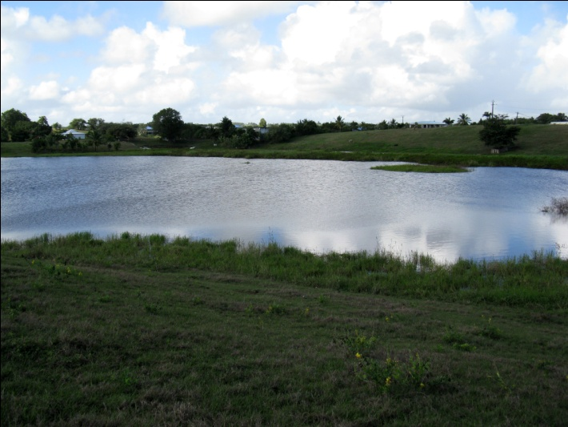
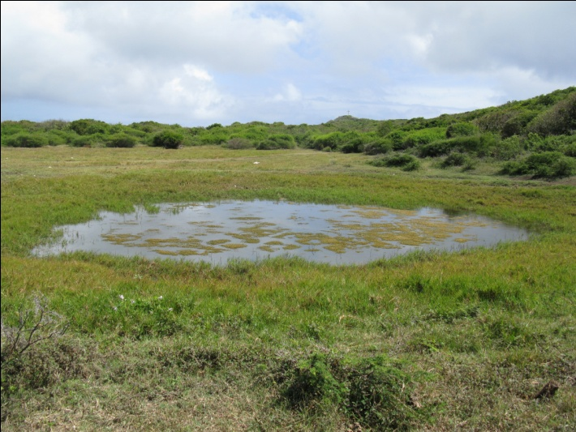
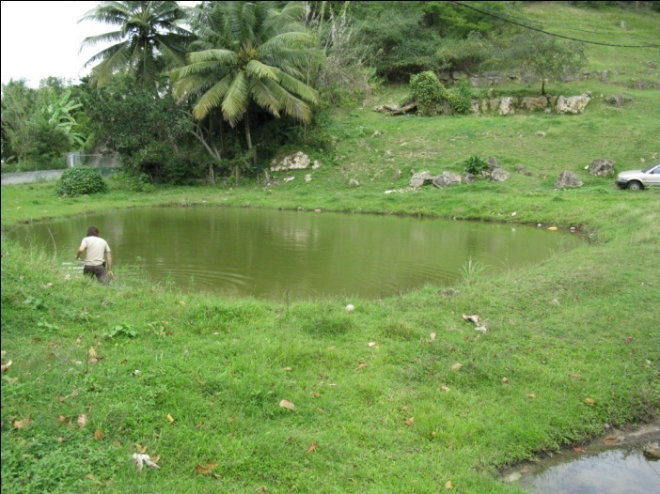
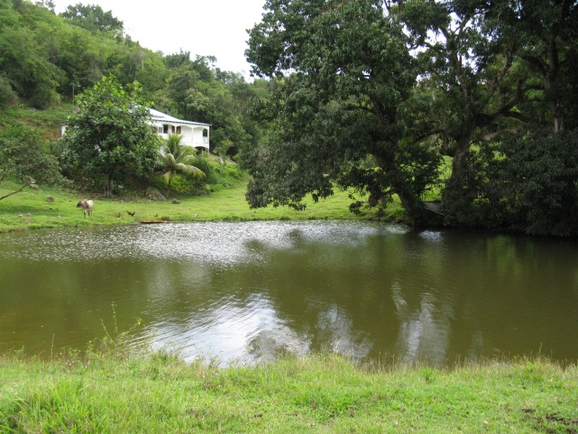
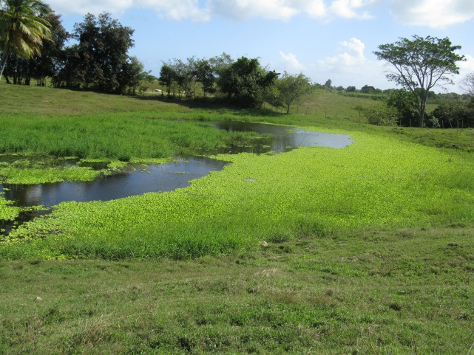
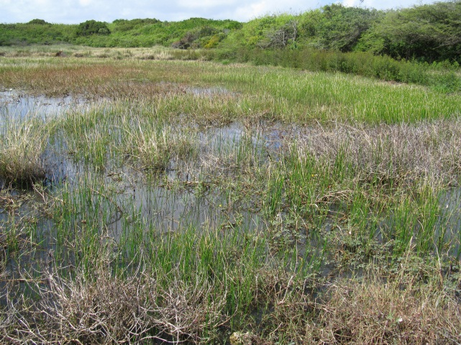
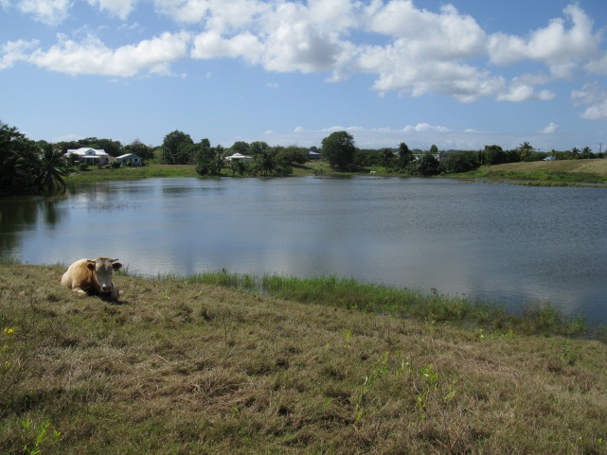
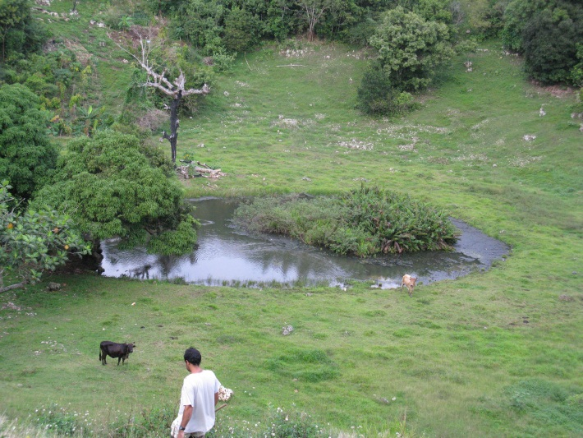
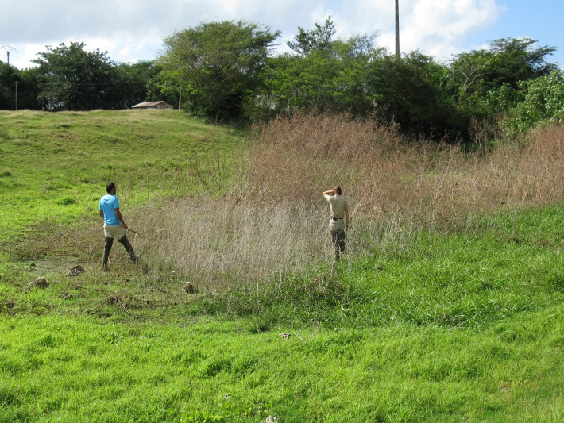
(photo credit: J-P Pointier)
Notes:
This network of ponds forms a mosaic of habitats that greatly vary with respect to their environmental conditions/characteristics

Slide 5
Size
(photo credit: J-P Pointier)
Notes:
Some ponds are big, some are very small (e.g. 2000 m vs 40 m)

Slide 6
Vegetation
cover
(photo credit: J-P Pointier)
Notes:
Some are covered with abundant and diversified vegetation, while others lack any vegetation.
Vegetation = resource and habitat for many freshwater species (mollusks).

Slide 7
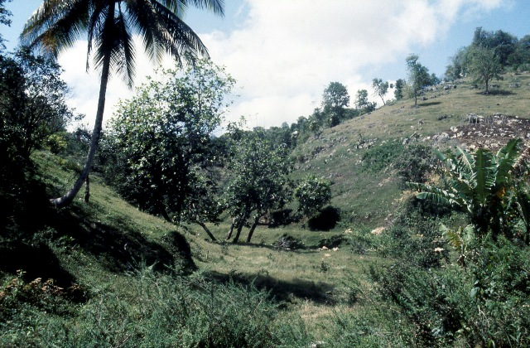
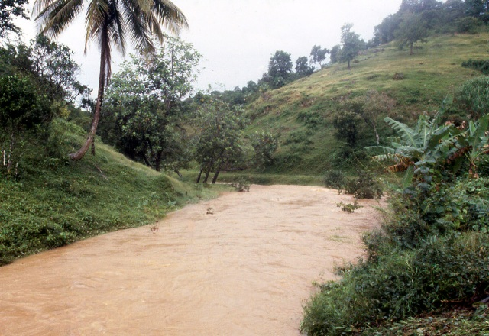

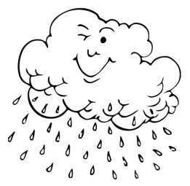
Freshwater ecosystems in the Guadeloupe archipelago
A naturally fragmented and highly unstable system
(photo credit: J-P Pointier)
(photo credit: J-P Pointier)
Temporal instability
Connectivity during the rainy season
Dry season
Rainy season
Dry season
t
Water level
Notes:
This network of ponds does not only form a naturally fragmented landscape of habitat, it is also a highly unstable system.
Indeed, the Guadeloupe archipelago is under the tropics, and freshwater ecosystems are therefore undergoing very strong temporal instability.
During the dry season (January to July) water level decreases in most freshwater environments, and in some of them water level can decreases up to total dry out.
During the rainy season (July to December), strong rainfall will refill freshwater environments, water levels will increase. Water will overflow insuring a hydrographic connection between some ponds depending on their degree of connectivity.
Note: the two pictures are from the same site

Slide 8
Instability
Notes:
As a consequences, ponds also vary with respect to they temporal instability. Some ponds never dry out and are very stable through time (same water level, no fluctuation in the vegetation cover, etc.), while some other ponds are very unstable through time and can totally dry out, either every years, and some years.

Slide 9
Connectivity
Notes:
Some ponds are highly connected to the hydrographic network of freshwater ecosystems. The upper pond has an outlet allowing water to flow in during the rainy season. The bottom pond is totally isolated, and never connected to any other ponds in the system.

Slide 10
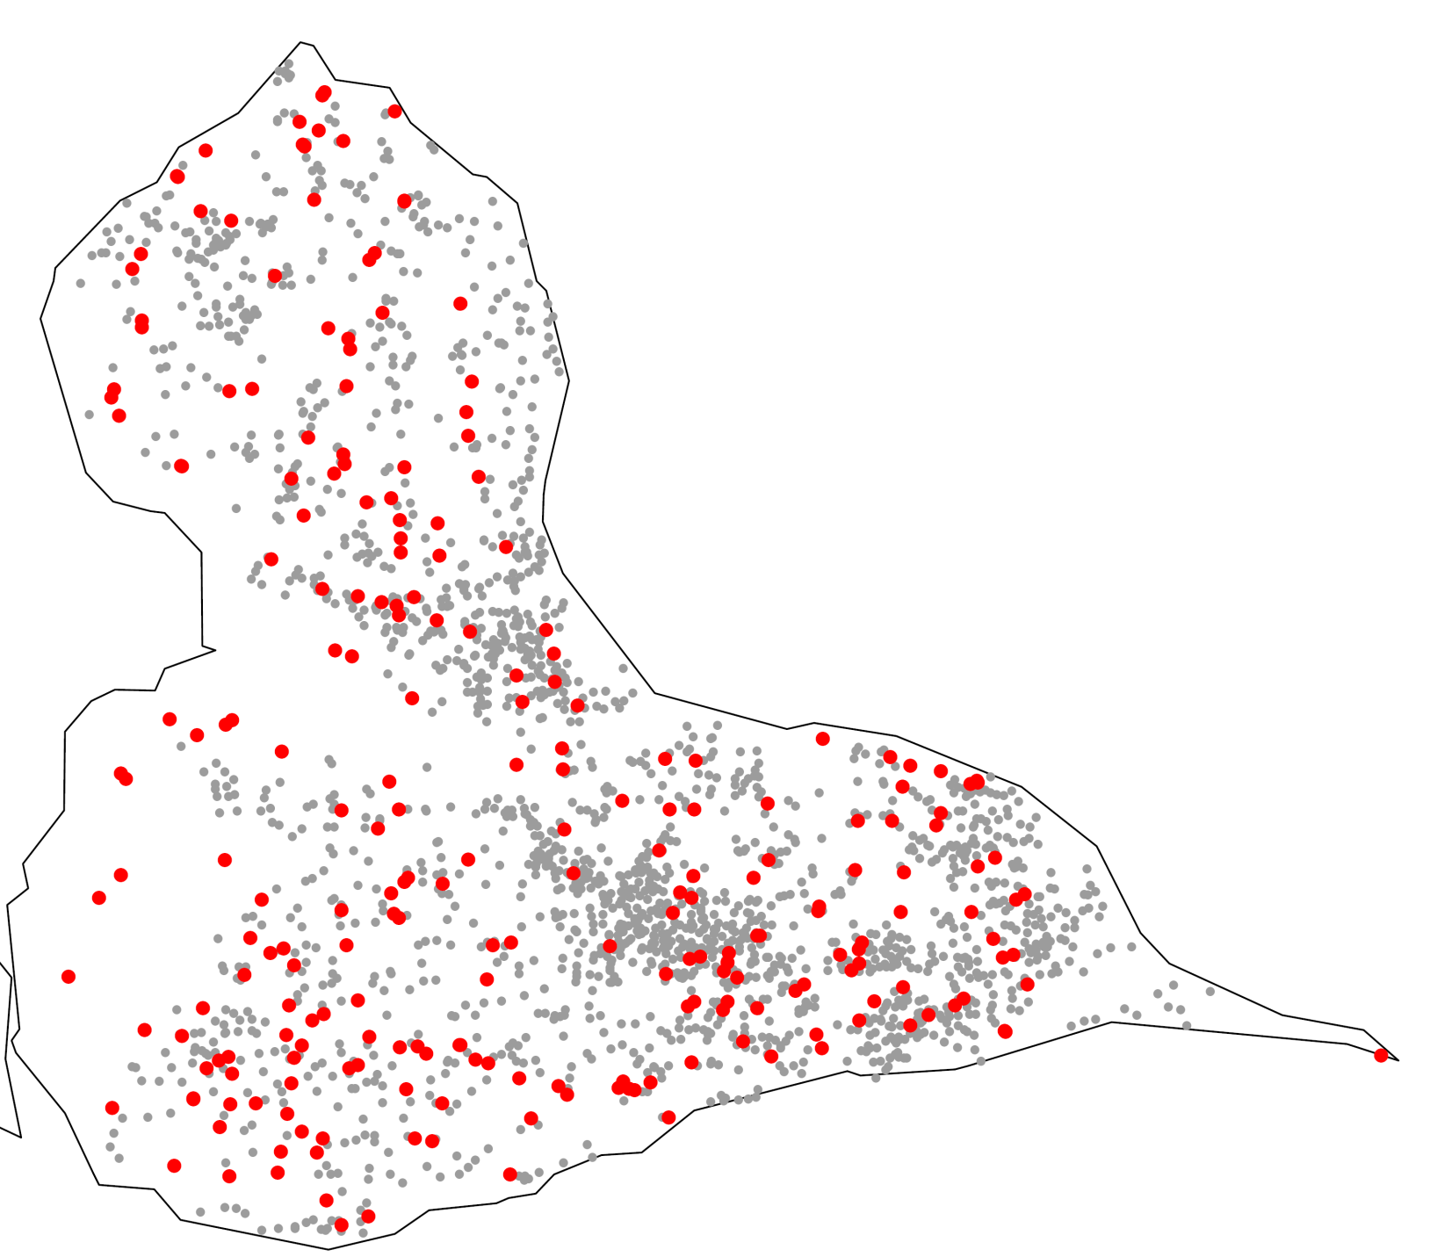

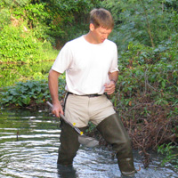


A yearly field surveys
An intensively surveyed system
240 surveyed ponds
2001-2011 : 11 years
Patrice David
Philippe Jarne
Jean-Pierre Pointier
ponds
surveyed ponds
Notes:
240 ponds are visited yearly from 2001. Work initiated in 2011 by Patrice David, Philippe Jarne and Jean-Pierre Pointier.

Slide 11
A yearly field surveys
1 – environmental characteristics
Size
Mean pond diameter over years
Vegetation cover
Mean vegetation cover over years
Connectivity
Connectivity to neighboring sites via the hydrographic network
Density of habitats
Number of water bodies within a radius of 2 km
Stability
Synthetic index: water stability, size and vegetation variance, etc. (PCA)
Notes:
Table 2 in Lamy et al. 2012

Slide 12
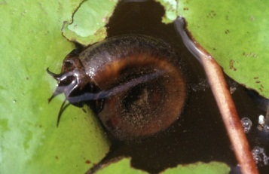
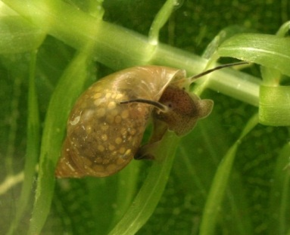
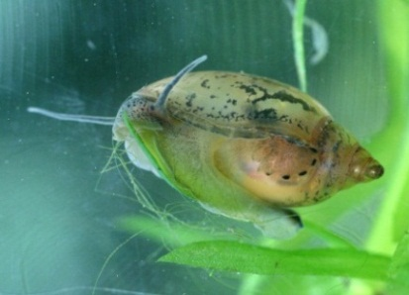
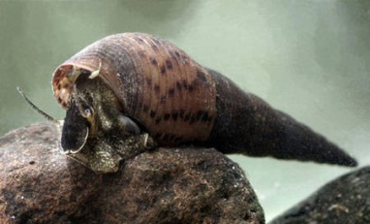
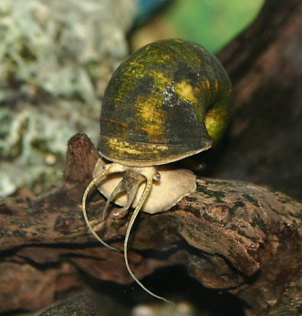
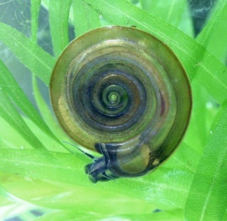
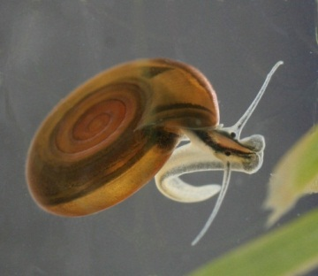
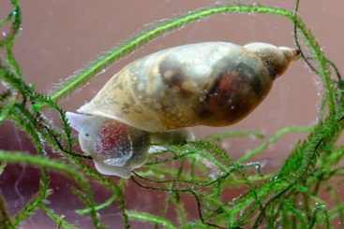
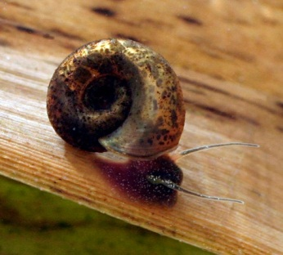
Freshwater ecosystems in the Guadeloupe archipelago
2 – Biotic characteristics: species Presence and abundance (semi-log)
Mollusks
=
Predominant biomass in these ecosystems
29 species
Pulmonata / Caenogastropoda
(photo credit: J-P Pointier)
Notes:
Freshwater mollusks represent the most important biomass and in the ecosystems. In Guadeloupe 29 species has been characterized, divided into two phylogenetic groups, Pulmonata and Caenogastropoda.
Pulmonata have short life cycles – very high densities
Caenogastropoda have longer life cycles – lower densities

Slide 13
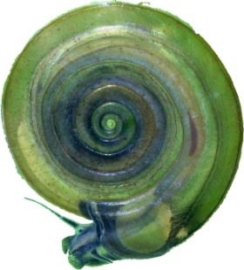
Testing metapopulation dynamics
A model species: Drepanotrema depressissimum
Very common
Short life cycles (4 months)
Outcrossing

Slide 14
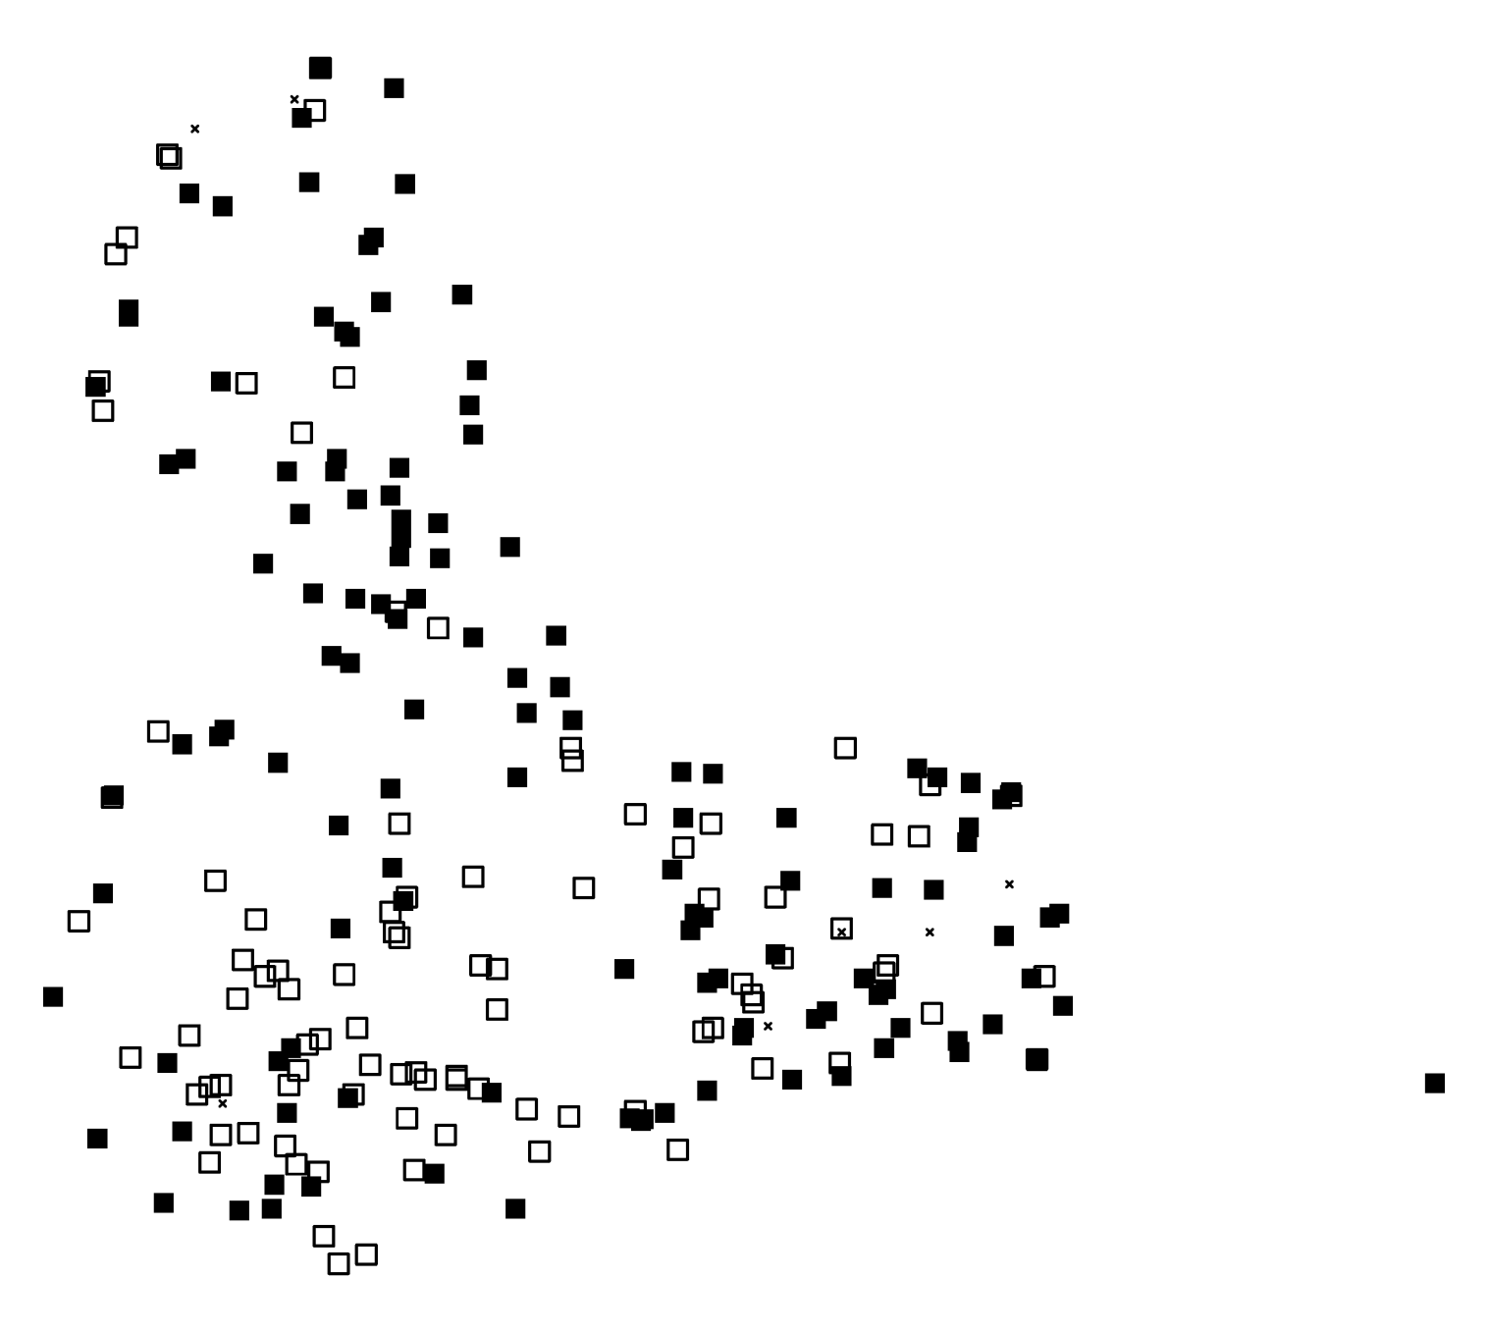
Dynamics of D. Depressissimum, a metapopulation?
D. depressissimum 2009
Species detected
Species not detected
Site not visited
x
10 Km

Slide 15
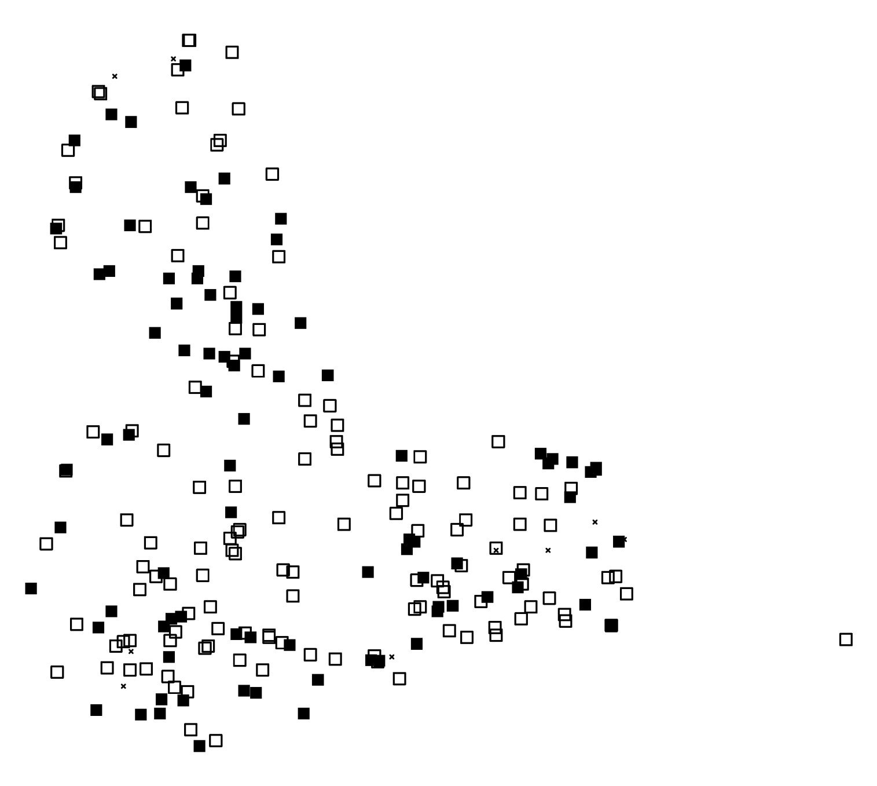
Dynamics of D. Depressissimum, a metapopulation?
D. depressissimum 2010
Species detected
Species not detected
Site not visited
x
10 Km

Slide 16
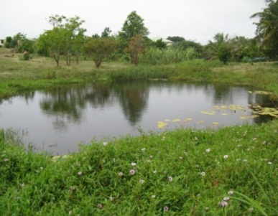

Dynamics of D. Depressissimum, a metapopulation?
2009-2010
Detected
Not detected
Apparent extinction
= 21,7 %
Apparent colonization
= 19,6 %
10 Km

Slide 17
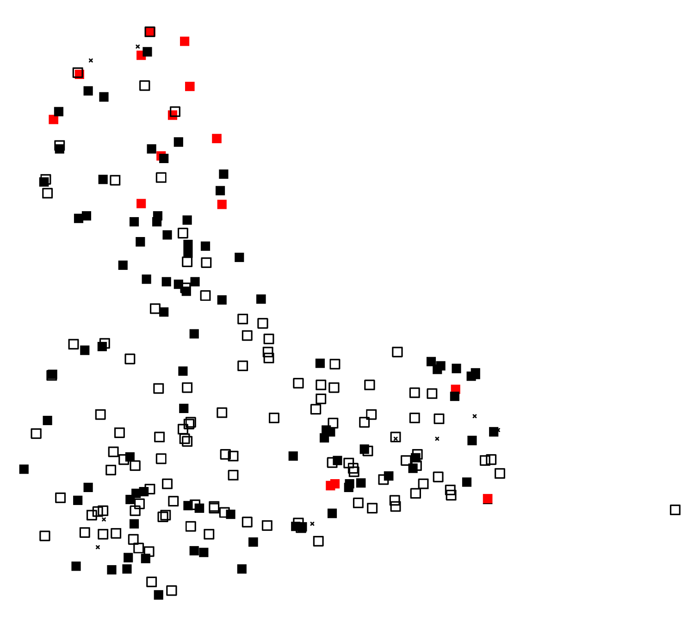
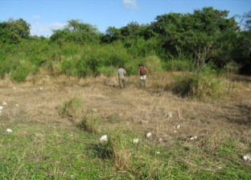
Dynamics of D. Depressissimum, a metapopulation?
2009-2010
Detected
Not detected
Apparent extinction
= 21,7 %
Apparent colonization
= 19,6 %
4,9 % of dried-out ponds
10 Km

Slide 18
Dynamics of D. Depressissimum, a metapopulation?
Hypothesis and alternative hypotheiss
Apparent extinctions and colonizations are frequent:
H1: Dynamics of D. depressissimum correspond to a metapopulation dynamics
Extinction-colonization dynamics dictated by the strong temporal instability of freshwater habitats?
Notes:
A strong pattern seems to arise from basic observations

Slide 19

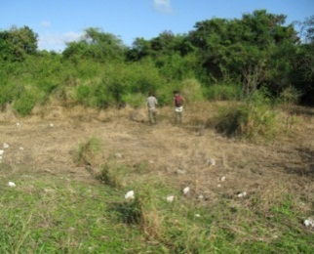

Dynamics of D. Depressissimum, a metapopulation?
Detectability
Dormancy
Species not detected
dried-out pond
aestivation
Pointier et Combes (1976)
Can D. depressissimum relies on aestivation to persist in the ground of dried-out ponds?
How much of apparent extinction is due to unperfected detection?
Notes:
Can we trust a overall impression?

Slide 20
Dynamics of D. Depressissimum, a metapopulation?
H1: Metapopulation
H2: Demographically stable model
Age
Connectivity
1
3
> 5
time
Size
Genetic diversity
Genetic diversity
Genetic diversity
Demographically stable model
Metapopulation
Age
Size
Connectivity
Relative importance of these three factors?

Slide 21
Dynamics of D. Depressissimum, a metapopulation?
1270 individuals
10 microsatellite markers
42 populations sampled in space and time
25 sites
4 spatial clusters of 3 neighboring populations
temporal sampling of 12 sites (2 to 4 years)
Non Apparent Population Extinction (7 sites)
Apparent Population Extinction (5 sites)

Slide 22
Dynamics of D. Depressissimum, a metapopulation?
1 – environmental characteristics
Size
Mean pond diameter over years
Vegetation cover
Mean vegetation cover over years
Connectivity
Connectivity to neighboring sites via the hydrographic network
Density of habitats
Number of water bodies within a radius of 2 km
Stability
Synthetic index: water stability, size and vegetation variance, etc. (PCA)
2 – Demographic characteristics
Apparent population age (APA)
years since the most recent potential founder effect
Long-term population size (N_{LT}) Combination of observed density and site size averaged over years
Notes:
Table 2 in Lamy et al. 2012

Slide 23
Factors underlying genetic diversity
Which factors underline genetic diversity?
Age / Size/ Connectivity / Stability
To which extent does habitat instability influence extinction-colonization cycles?
Can we predict species dynamics based on habitat dynamics?
Extinction is not as important as previously thought:
many apparent extinction are false

Slide 24
Supplementary material to illustrate the temporal components of the analysis
Notes:
Table 2 in Lamy et al. 2012

Slide 25

A direct test of extinction
Direct test
Comparing the genetic footprint of a pond before and after an apparent extinction
Apparent extinction
Local genetic pool
Extinction
=
Total replacement of local genetic pool
Regional genetic pool

Slide 26
A direct test of extinction
Direct test
Comparing the genetic footprint of a pond before and after an apparent extinction
Apparent extinction
Local genetic pool
No extinction
=
Persistence of local genotypes
Regional genetic pool

Slide 27

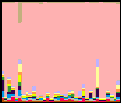
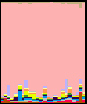
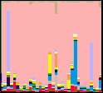
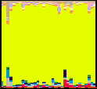
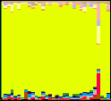
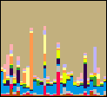
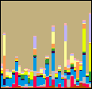
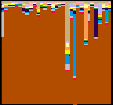
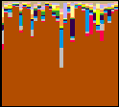
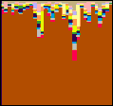
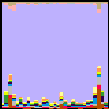
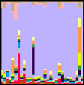
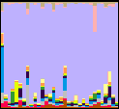
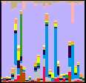
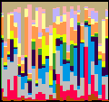














Time
Sampled populations
2006
2007
2008
2009
2010
2011
Species detected
Population 1
Population 2
Population 3
Stable populations
Population 4
Population 5
Space
Population 6
Population 7
Population 8
Population 9
Population 10
Apparent extinction
Population 11
Species not detected
Population 12
Dried-out pond

Slide 28
Time
Clustering
Groups are not predefined, they are defined based on genotypic information
2006
2007
2008
2009
2010
2011
Population 1
Population 2
Group 1
Population 3
Group 2
Population 4
Group 3
Group 4
Population 5
Space
Group 5
Population 6
Groupe6
…
Population 7
Etc.
Population 8
Population 9
Population 10
Apparent extinction
Population 11
Species not detected
Population 12
Dried-out pond

Slide 29

Time
Clustering
Groups are not predefined, they are defined based on genotypic information
2006
2007
2008
2009
2010
2011
Population 1
Population 2
Group 1
Population 3
Group 2
Population 4
Group 3
Group 4
Population 5
Space
Group 5
Population 6
Group 6
…
Population 7
Etc.
One individual
Population 8
Population 9
Population 10
Apparent extinction
Population 11
Species not detected
Population 12
Dried-out pond

Slide 30









Time
Clustering
Groups are not predefined, they are defined based on genotypic information
2006
2007
2008
2009
2010
2011
Population 1
Population 2
Population 3
Stable populations
Population 4
Population 5
Space
Population 6
Population 7
Population 8
Population 9
Population 10
Apparent extinction
Population 11
Species not detected
Population 12
Dried-out pond

Slide 31
Time
Clustering
Groups are not predefined, they are defined based on genotypic information
2006
2007
2008
2009
2010
2011
Population 1
Population 2
Population 3
Stable populations
Population 4
Population 5
Space
Weak temporal structuration
F_{ST} = 0.003
Population 6
Population 7
Strong spatial structuration
F_{ST} = 0.065
Population 8
Population 9
Population 10
Apparent extinction
Population 11
Species not detected
Population 12
Dried-out pond

Slide 32





Time
Clustering
Groups are not predefined, they are defined based on genotypic information
2006
2007
2008
2009
2010
2011
Population 1
Population 2
Population 3
Stable populations
Population 4
Population 5
Space
Weak temporal structuration
F_{ST} = 0.003
Population 6
Population 7
Strong spatial structuration
F_{ST} = 0.065
Population 8
Population 9
Population 10
Apparent extinction
Population 11
Species not detected
Population 12
Dried-out pond

Slide 33
Probability that individuals sampled after an apparent extinction come from the same population
Assigned to the same pond
Not assigned to the same pond

Slide 34

What did genetic data tell us?
D. depressissimum efficiently aestivate (« seed bank »)
Many apparent extinctions are false ones
Permanent differences among ponds (connectivity and size) are the main sources of variation in genetic diversity
A the scale investigated, extinction plays a minor role on genetic diversity
Lamy et al (2012) Mol Ecol, 21, 1394-1410

